Slide 1
Learning Transfer
Transfer of Learning is ensuring what people learn on training programs is transferred into real business results.
Learn how transfer of learning enables individuals to transfer new skills and knowledge from a learning environment into their habitual behaviors at work. Effective learning transfer is essential for maximizing learning outcomes.
It’s a proven way to make sure participants take what they learn in training back to their day-to-day job.
http://transferoflearning.com/
Click pics to discover and learn more…
Marlo Calloway, SHRM-CP/PHR

Slide 2
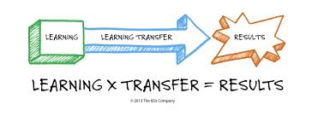
Takeout Learning: 4 Tips to Encourage Learning Transfer

Slide 3
What Influences Learning Transfer Among Professionals?

Slide 4
ATD Learning Transfer Certificate

